Slide 1

QUIZ :
FAMOUS PERSONALITIES OF INDIA

Slide 2
RULES
There will be six teams and each team will consist of two students.
There will be 6 rounds and students will get one mark for each correct answer and no negative marking will be done for wrong answer.
If a team cannot answer the question, they can pass the question & then the question would be forwarded to the audience.
Answering time is only 30 seconds.
Team discussion is allowed.

Slide 3
ROUND - 1
IDENTIFY THE FAMOUS PERSONALITIES

Slide 4
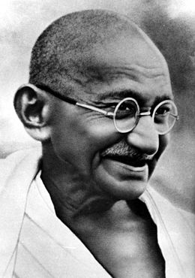
TEAM-A

Slide 5
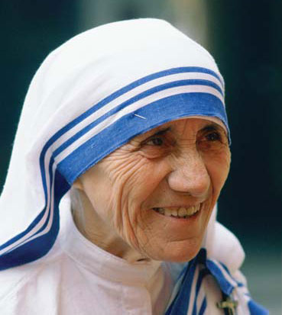
TEAM- B

Slide 6
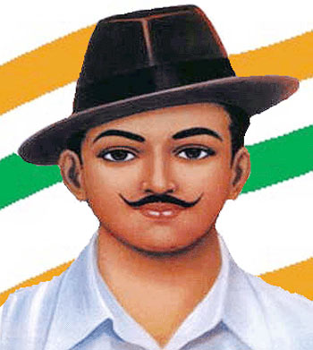
TEAM - C

Slide 7
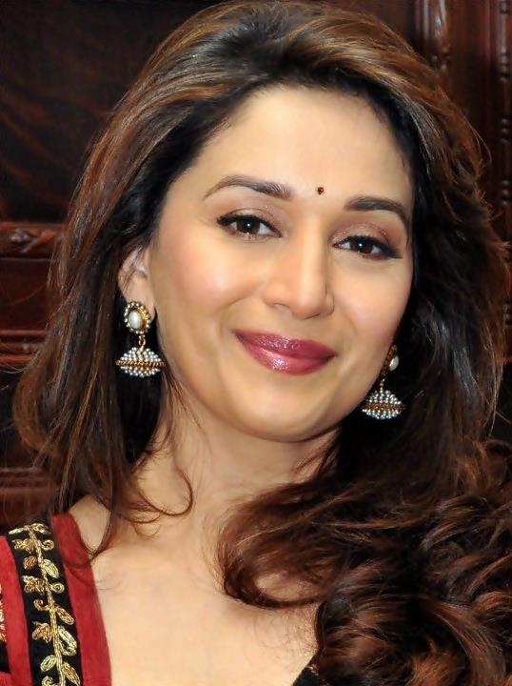
TEAM - D

Slide 8
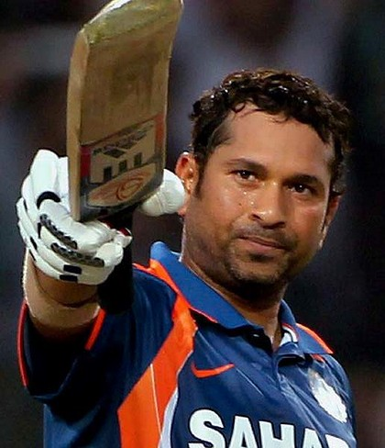
TEAM - E

Slide 9
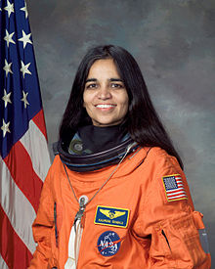
TEAM - F

Slide 10

ROUND - 2
FREEDOM FIGHTERS

Slide 11
TEAM - A
WHOSE BIRTHDAY IS CELEBRATED AS CHILDREN’S DAY?

Slide 12
TEAM - B
WHICH FREEDOM FIGHTER IS ADDRESSED AS ‘BAPU’ BY THE PEOPLE ?

Slide 13
TEAM - C
NAME THE FREEDOM FIGHTER WHO IS ADDRESSED AS ‘JHANSI KI RANI’?

Slide 14
TEAM - D
WHO GAVE THE SLOGAN- ‘SWARAJ IS MY BIRTHRIGHT’ .

Slide 15
TEAM - E
WHO IS KNOWN AS THE ARCHITECT OF THE INDIAN CONSTITUTION?

Slide 16
TEAM - F
WHO WAS THE FOUNDER OF ‘AZAD HIND FAUJ’?

Slide 17
ROUND – 3
FAMOUS POLITICIANS

Slide 18
TEAM - A
NAME THE FIRST FEMALE PRIME MINISTER OF INDIA.

Slide 19
TEAM - B
NAME THE CURRENT PRIME MINISTER OF INDIA.

Slide 20
TEAM - C
NAME THE PERSON WHO RECENTLY RESIGNED FROM THE POST OF DELHI’S CHIEF MINISTER.

Slide 21
TEAM - D
NAME THE CURRENT PRESIDENT OF INDIA.

Slide 22
TEAM - E
WHO IS THE FATHER OF OUR NATION?

Slide 23
TEAM - F
WHO WAS THE FIRST PRIME MINISTER OF INDIA?

Slide 24
ROUND - 4
FAMOUS ACTORS

Slide 25
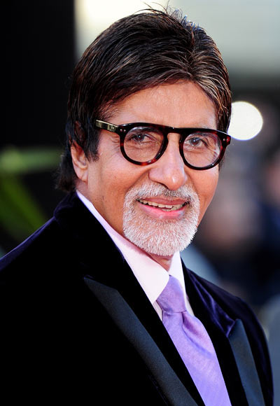
TEAM - A
NAME THE ACTOR WHO PRESENTED THE FAMOUS SHOW ‘KAUN BANEGA CROREPATI’.

Slide 26
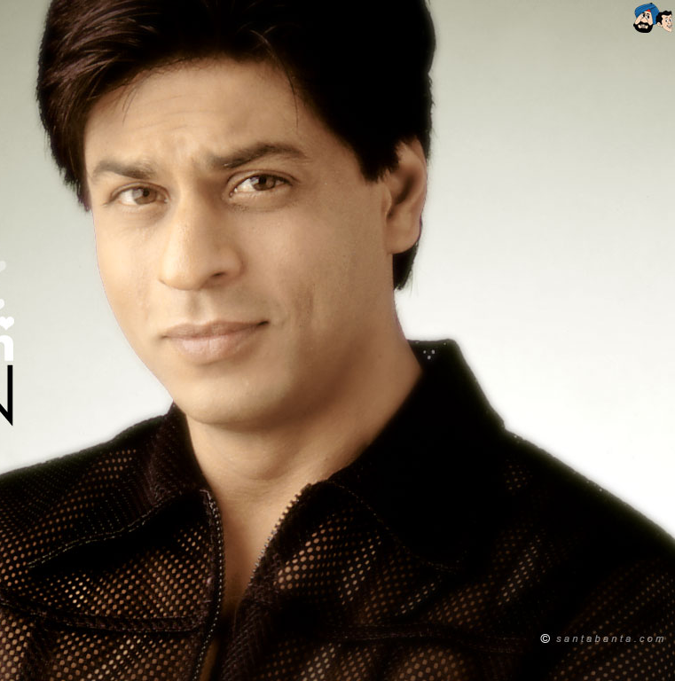
TEAM - B
NAME THE ACTOR WHO IS ALSO CALLED AS ‘THE KING KHAN OF BOLLYWOOD’.

Slide 27
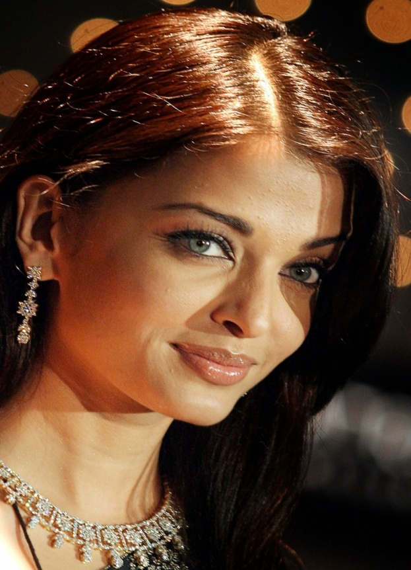
TEAM - C
WHICH ACTRESS WON THE MISS WORLD PAGEANT IN 1994?

Slide 28
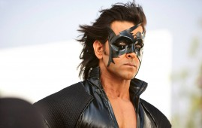
TEAM - D
NAME THE ACTOR WHO GAVE AN OUTSTANDING PERFORMANCE IN THE MOVIE ‘KRRISH 3’.

Slide 29
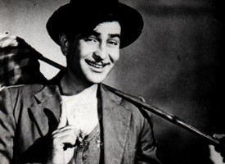
TEAM - E
NAME THE VETERAN ACTOR WHO ESTABLISHED THE R.K.FILMS STUDIO.

Slide 30
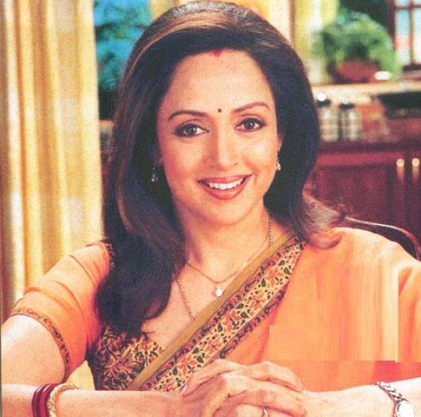
TEAM - F
NAME THE ACTRESS WHO IS A BHARATNATYAM DANCER AND IS ALSO KNOWN AS THE ‘DREAM GIRL’ OF BOLLYWOOD.

Slide 31
ROUND – 5
FAMOUS SPORTSPERSONS

Slide 32
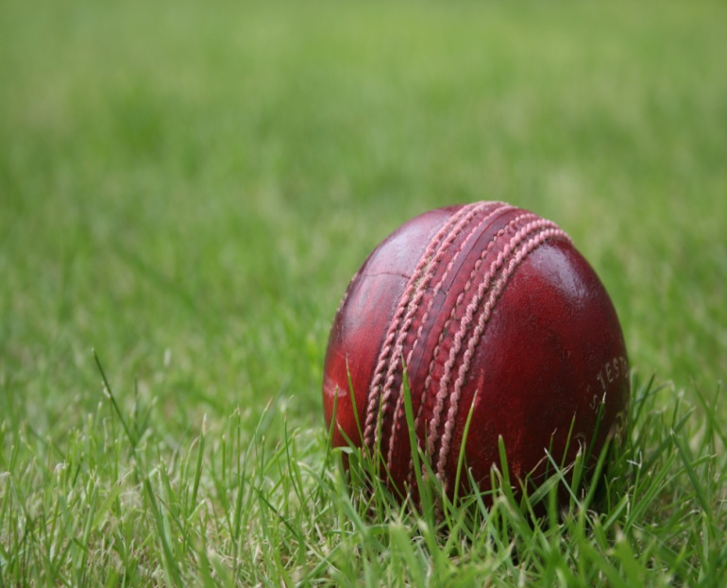
TEAM - A
WHICH INDIAN CRICKETER GOT THE BHARAT RATNA AWARD RECENTLY?
SACHIN TENDULKAR
OR
KAPIL DEV

Slide 33
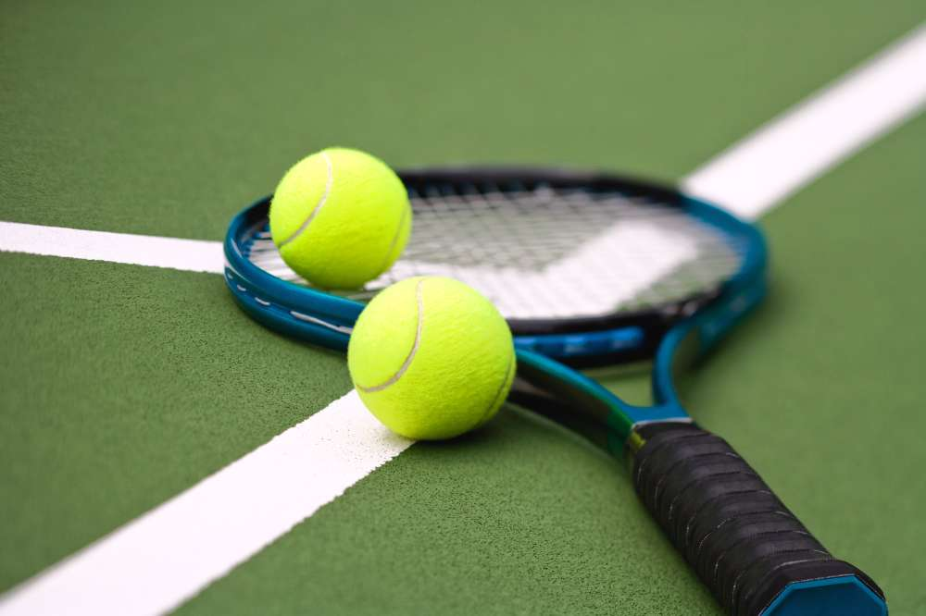
TEAM - B
WHICH TENNIS PLAYER WON THE 2012 FRENCH OPEN – MIXED DOUBLES EVENT ?
ANKITA RAINA
OR
SANIA MIRZA

Slide 34

TEAM - C
WHICH INDIAN ATHLETE IS ALSO REFERRED AS ‘THE FLYING SIKH’?
MILKHA SINGH
OR
ABHINAV BINDRA

Slide 35
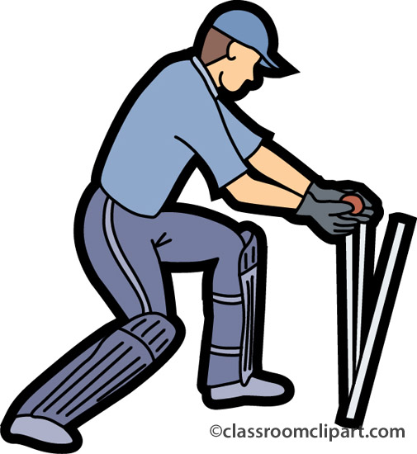
TEAM - D
WHO IS THE CURRENT CAPTAIN OF THE INDIAN CRICKET TEAM?
YUVRAJ SINGH
OR
MS DHONI

Slide 36
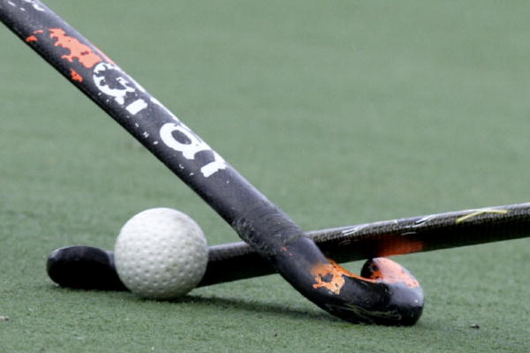
TEAM - E
WHICH HOCKEY PLAYER WON THREE OLYMPIC GOLD MEDALS (IN 1928, 1932, and 1936)?
DHYAN CHAND
OR
SANDEEP SINGH

Slide 37
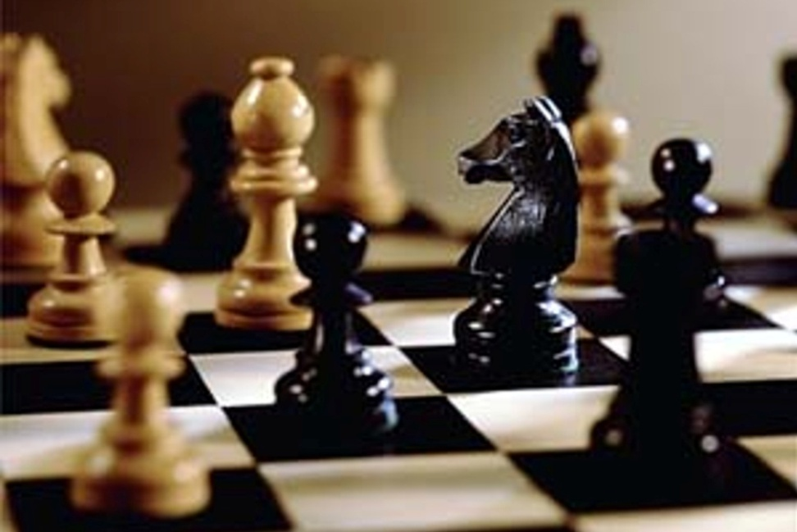
TEAM - F
WHO IS THE INDIAN CHESS GRANDMASTER?
VISHWANATHAN ANAND
OR
LEANDER PAES

Slide 38
ROUND - 6
FAMOUS
MUSICIANS & DANCERS

Slide 39
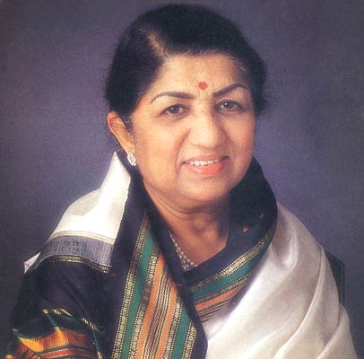
TEAM - A
VETERAN SINGER LATA MANGESHKAR SINGS ONLY HINDI SONGS.
TRUE
OR
FALSE

Slide 40
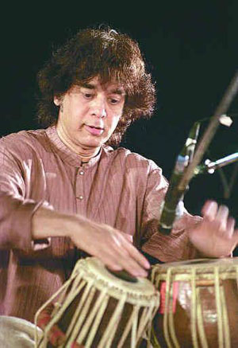
TEAM - B
ZAKIR HUSSAIN IS A TABLA PLAYER WHO WAS AWARDED PADMA BHUSHAN AWARD IN 2002.
TRUE
OR
FALSE

Slide 41
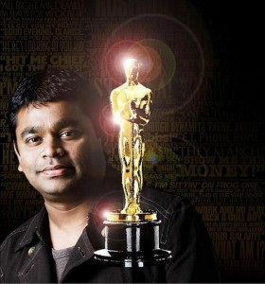
TEAM - C
A.R. REHMAN COMPOSED THE MUSIC OF THE MOVIE SLUMDOG MILLIONAIRE.
TRUE
OR
FALSE

Slide 42

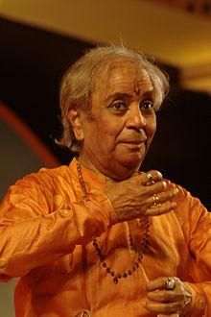
TEAM - D
PANDIT BIRJU MAHARAJ IS A LEADING KATHAK DANCER.
TRUE
OR
FALSE

Slide 43
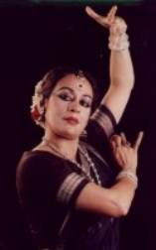
TEAM - E
SONAL MANSINGH IS A RENOWNED SITAAR PLAYER.
TRUE
OR
FALSE

Slide 44
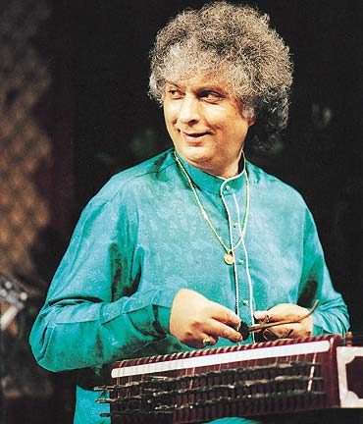
TEAM - F
PANDIT SHIV KUMAR SHARMA IS THE SANTOOR MAESTRO OF INDIA.
TRUE
OR
FALSE

Slide 45
WELL DONE!

